Slide 1

v.0.0.1

Slide 2
Using your Web Browser,
Open this URL:
Click on the workshop you’re attending, and find:
1
http://mlhlocal.host/lhd-resources
2
Setup Instructions
The Code Samples
A demo project
A Workshop FAQ
These Workshop Slides
More Learning Resources
Notes:
What to Say:
Tell attendees we are going to check them in for the event
Once attendees check in, they will receive an email with the items listed on the slide
Attendees must check-in to get credit for attending this event
What to Do:
Confirm that everyone has checked in by asking participants to give you a signal when they receive the email.

Slide 3

Our Mission is to Empower Hackers.
65,000+
HACKERS
12,000+
PROJECTS CREATED
3,000+
SCHOOLS
We hope you learn something awesome today!
Find more resources: http://mlh.io/
Notes:
What to Say:
Major League Hacking (MLH) events are meant to bring hackers together so they can learn, build, and share.
Give participants a brief overview of Major League Hacking (MLH).
Tell participants they can learn more at http://mlh.io/
Example Talking Points:
TODO
Through Localhost MLH is rethinking technology education to reflect how hackers actually learn and how fast the industry moves.
Here’s some quick facts about MLH:
Each year, MLH supports over 65,000 hackers around the world at events they facilitate
Those students create more than 12,000 amazing projects together
MLH is a global organization that empowers hackers in more than 400 cities and growing every day

Slide 4
What will you learn today?
1
The basics of configuring a Twilio phone number
2
How to set up automatic SMS and call responses with TwiML
3
Getting started with TwilioQuest to learn even more!
Notes:
What to Say:
Explain to participants what they will learn today
Learning is a core part of being a hacker and today they are going to learn something new
What to Do:
Get participants excited about the experience.

Slide 6

Who has heard of Twilio?

Slide 7
What does Twilio do?
It’s a cloud communication Platform as a Service (PaaS). Twilio can automate sending and receiving:
SMS (texts)
Phone calls
Video
… And more!
Key Term
Platform as a Service (PaaS): A platform for developers to build internet applications without having to build and maintain the underlying infrastructure (e.g. servers) themselves.

Slide 8
Let’s See it in Action!
Send this number an SMS message - it doesn’t matter what the message text is.
+1 (626) 727 8314
Notes:
Notes: this is a US number and will cost a fee for outside the US. For example, network rates are about 10p per text message from a UK-based number.

Slide 9
How's THAT for a RickRoll?
Let’s see what’s happening behind the scenes.

Slide 10
What happened when you called?
1
You sent an SMS to a Twilio phone number.
Twilio received the call and called a Webhook to reply to it.
The Webhook request triggered a function call from our live Glitch app.
The function wrote a response (the music file) and sent it back to the Twilio server, who played it to you!
2
3
4
Key Term
Webhook: A URL that is triggered when the Twilio number receives an SMS or call. It links to our application to write a response.
Notes:
Speaker moves to twilio.com/console

Slide 11




1
User sends SMS to Twilio number
Twilio sends a request for a response to the live Glitch app through the Webhook URL
2
Twilio plays the response back to us!
4
Twilio Account
Our app writes the response to the call
3
Notes:
Speaker moves to twilio.com/console

Slide 12

A Quick Tour
What tools are involved in making this?
Twilio
Twilio allows us to create SMS and Voice apps. You send a text and it starts running an app behind the scenes.
Glitch
Glitch lets you code right in the browser and deploy it instantly!

Slide 13
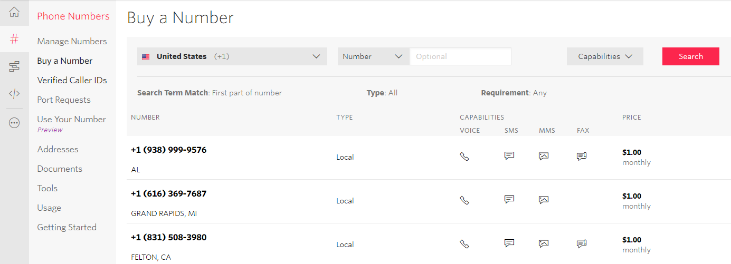
Setting up Twilio
We created a Twilio Account and registered a Twilio Number.

Slide 14
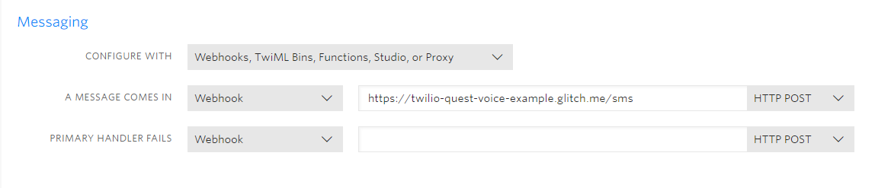
Setting up Twilio
We configured our new number.
When it receives a call, it triggers a Webhook to our live Glitch App.

Slide 15
Our Glitch Application
Let’s take a look at our Glitch App and see how it works!
Head to this URL:
mlhlocal.host/twilioquest-code

Slide 16
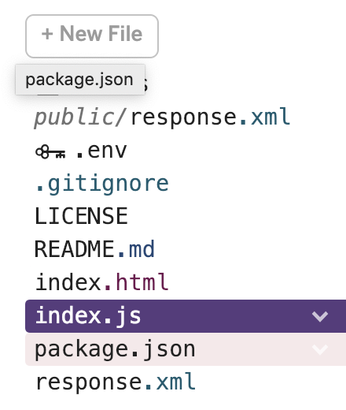
Our Glitch Application
Click on index.js in the left panel.

Slide 17
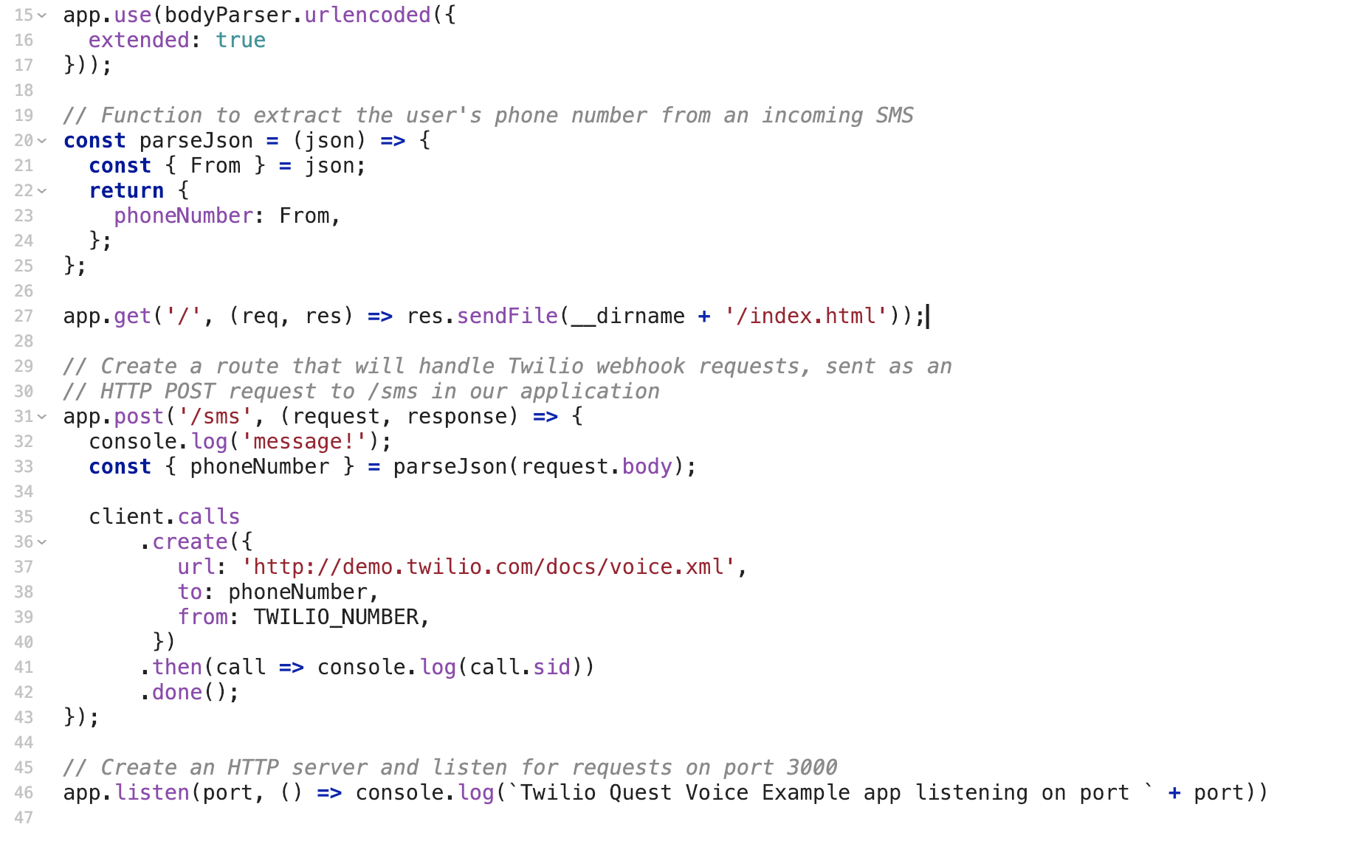
index.js

Slide 18
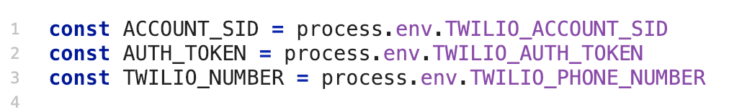
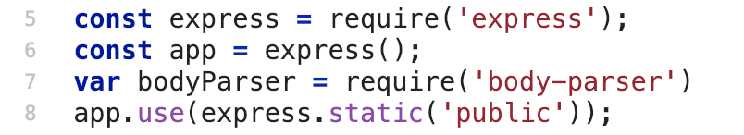
How does it work?
Lines 1-3 allow your app to use your environment variables (listed in .env).
Lines 5 and 7 import the necessary JavaScript packages.
Express is a web framework for Node.js
Line 6 launches the app server with a call to express().
Line 8 tells the app where to find static files.

Slide 19
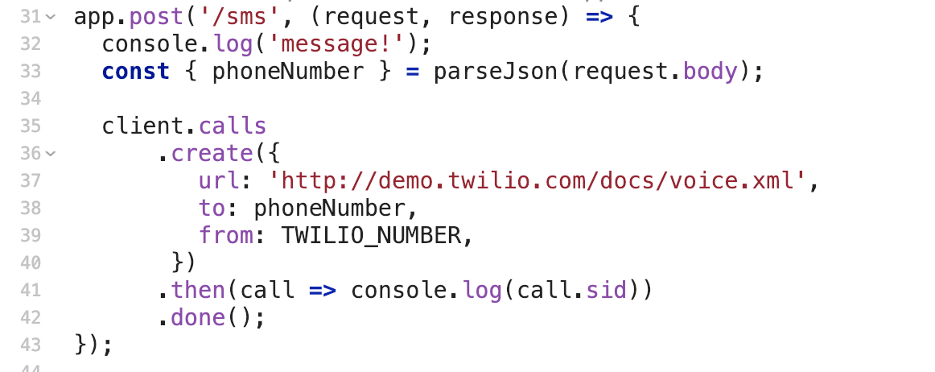
How does it work?
Line 31 starts to create a response when our app receives a text message ( /sms is requested from our Webhook).
Lines 35-42 creates a voice response which contains a music file and sends it the person who texted our Twilio number.

Slide 20

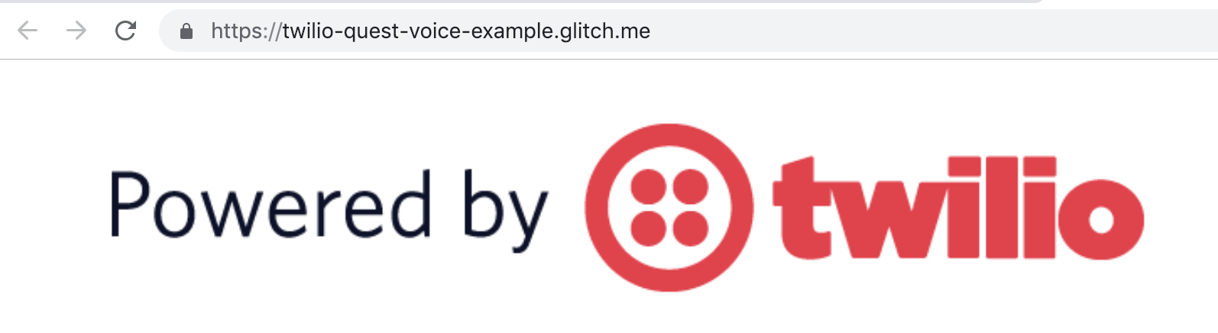
Launching the Glitch App
At the top of the Glitch window, click Show.
Check out the URL of the page that opens - it’s our Webhook URL!

Slide 21
Over to you...
We’re going to show you how to get started with TwilioQuest!

Slide 23

Registering for TwilioQuest
TwilioQuest is an interactive, self-paced game that teaches you how to use Twilio.
We’re going to help you register and start using TwilioQuest, then leave you to start fulfilling Missions!

Slide 24

TwilioQuest
Head to this URL and let’s begin!
http://twilio.com/quest
Press Enter on your keyboard.

Slide 25
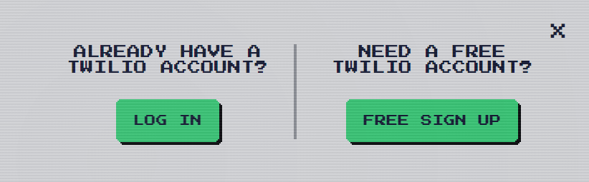

TwilioQuest: Log In
Click Sign Up and sign up for Twilio!
After signing up, you’ll be redirected back to TwilioQuest.

Slide 26
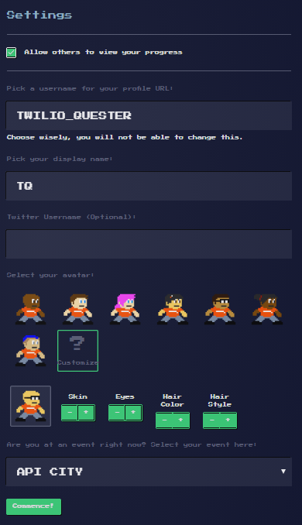
TwilioQuest: Log In
Tick ‘Allow others to view your progress’
Type a username and a display name
Pick or customize an avatar
Select MLH Localhost 2019 as your event
Click Commence!

Slide 27
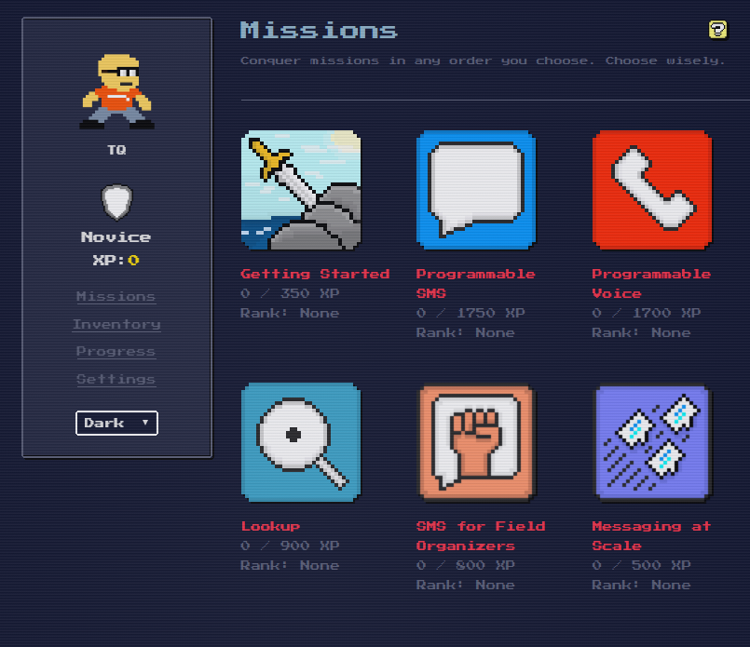
TwilioQuest: Your Dashboard
From your dashboard, you can choose missions and learn new Twilio Skills on the way.
The Getting Started and Programmable SMS missions will take you through what we’ve demoed already.
Let’s start gaining XP!

Slide 28
Your turn! You have _____ minutes to journey through your Quest!

Slide 29
Let's Check out the Leaderboard
https://www.twilio.com/quest/leaderboard/mlh-localhost-2019

Slide 31
That was awesome! Let's celebrate!

Slide 33

Let’s recap quickly...
1
Twilio is a PaaS platform which allows you add communication functionality to your projects.
2
You can set up automatic responses to SMS and calls by writing TwiML code.
3
You can learn more about Twilio by playing TwilioQuest!

Slide 34
What did you learn today?
We created a fun quiz to test your knowledge and see what you learned from this workshop.
http://mlhlocal.host/quiz

Slide 35
Where to go from here...
1
Think about what kind of applications you could build to make use of your new Twilio knowledge
2
Host the MLH Memes: Build Your Own Twilio App module: mlhlocal.host/apply
3
Complete the additional practice problems. These problems & way more are in your email!

Slide 36

Learning shouldn't stop when the workshop ends...
Check your email for access to:
These workshop slides
Practice problems to keep learning
Deeper dives into key topics
Instructions to join the community
More opportunities from MLH!

Slide 37
v.0.0.1

